Slide 1
Introduction to single-cell RNA-seq analysis (Day 2)
Jeremy M. Simon, Ph.D.
Assistant Professor, Department of Genetics
Director, UNC Neuroscience Center Bioinformatics Core
Co-Principal, Bioinformatics and Analytics Research Collaborative (BARC)

Slide 2
Outline for my section
Day 1
Rationale: Why do single-cell RNA-seq?
Overview of experimental methodologies/platforms
Best practices for experimental design
Overview of data processing tools
Workshop: Begin analysis of scRNA-seq data from E18 mouse cortex
Day 2
Workshop: Continue analysis of scRNA-seq data from E18 mouse cortex
Overview of cell type annotation
Overview of data handling with multiple conditions and differential expression
Overview of pseudotiming
Brief discussion of other scRNA-adjacent approaches to be aware of
List of other available resources

Slide 3
Cell type annotation: manual or automated?
No matter how you slice it, annotating the clusters you get is not an easy task
Why? There is rarely a “gold-standard” reference
Compared to something published, are your cells…
The same type/composition?
From the same age animal/donor?
From the same experimental treatments/conditions?
Isolated with the same platform?
Sequenced at the same depth and number of cells overall?
Probably not…
Lots of published (non-scRNA) data rely on protein-level expression and/or cell surface markers, this may not correlate with cellular or nuclear transcript abundance
T-cells are notoriously challenging since CD4/CD8 are unreliable markers at the single-cell level

Slide 4
Cell type annotation: manual or automated?
Tools are emerging for automated cell annotation
One example: Azimuth
https://azimuth.hubmapconsortium.org/
Azimuth leverages a ‘reference-based mapping’ pipeline that inputs a counts matrix of gene expression in single cells, and performs normalization, visualization, cell annotation, and differential expression (biomarker discovery)
The success of these tools will vary and depend heavily on how similar the reference is to your own experiment

Slide 5
Cell type annotation: manual or automated?
Manual annotation is usually the way to go (for now)
Inspect in situ data from Allen Brain Atlas or similar resources and consult published single-cell studies when available
Annotations and cluster stringency can be a lengthy and iterative process
Experimental validation may be necessary to prove your putative novel cell type exists (e.g. HCR, FISH, etc)

Slide 7
How to incorporate multiple replicates and conditions
Largely the same process and code as before
QC and filter all cells together, then split into one Seurat object per sample (e.g. WT_rep1, KO_rep3, etc)
Use SplitObject() to create a list
Run SCTransform() on each object in the list
lapply(X = your.list, FUN = SCTransform, …)
Utilize Seurat’s integration framework to merge the individual samples back together
SelectIntegrationFeatures()
PrepSCTIntegration()
FindIntegrationAnchors()
IntegrateData()
Proceed with RunPCA(), RunUMAP() as before
More info here:
https://satijalab.org/seurat/articles/sctransform_v2_vignette.html#perform-integration-using-pearson-residuals-1

Slide 8
How to incorporate multiple replicates and conditions
IntegrateData() populates the object@assays$integrated slots
Current recommendations are to use this for clustering and pseudotiming only, not for plotting or differential expression
https://github.com/satijalab/seurat/discussions/4000 among others
This means you must be very careful about which assay/slot you’re accessing and what form those data are in
Some other downstream methods may require data to be normalized a certain way, which further complicates this!

Slide 9
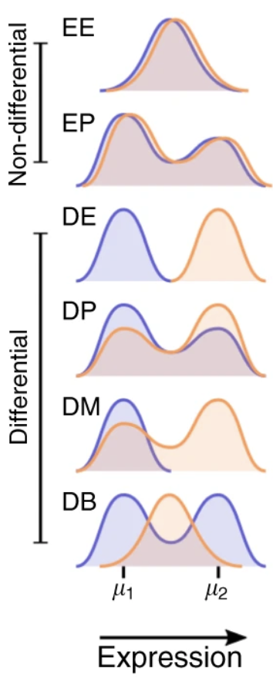
Considerations for differential expression
What is differential expression in this context anyway?
Actually takes many forms, and each may not be captured by the same statistic!
Differential cell proportions and differential expression can both occur in the same cell type
Many now utilizing “pseudo-bulk” aggregates of cells followed by conventional differential expression methods (e.g. DESeq2, limma)
No matter what method, it is vitally important to make use of replicate variability information rather than treating each cell as independent
https://www.biorxiv.org/content/10.1101/2022.02.16.480517v1
Crowell, et al, Nat Comms, 2020

Slide 10
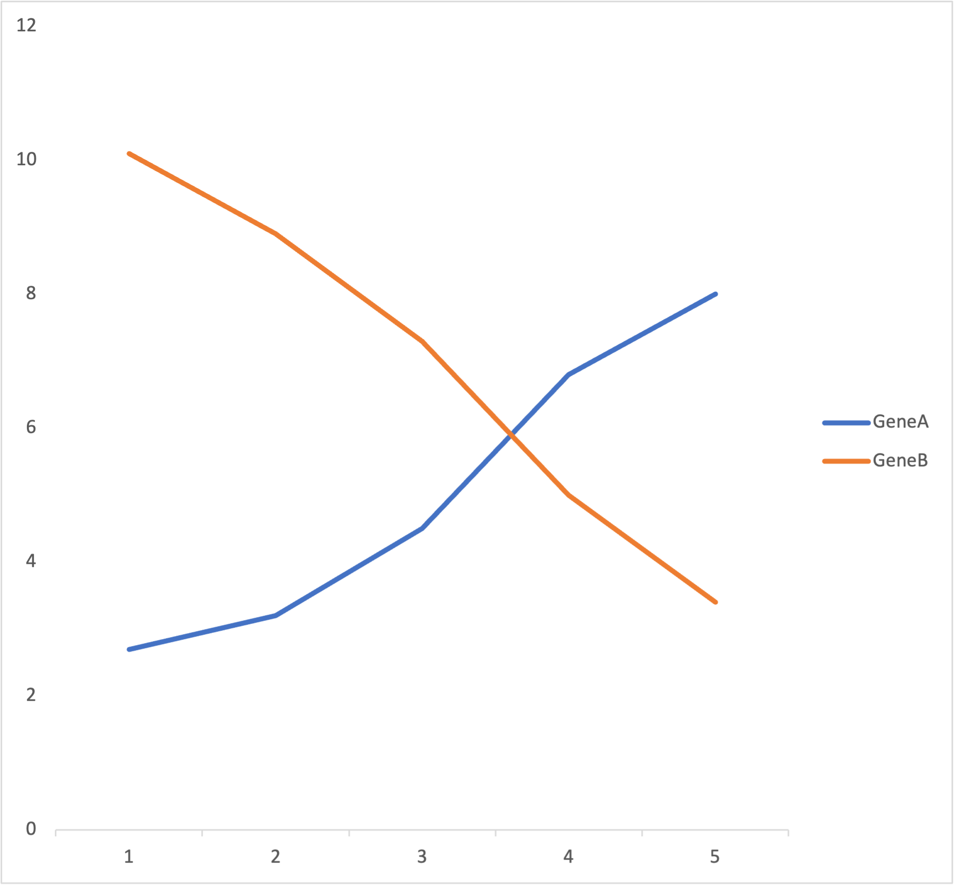
Pseudotiming/trajectory analysis
If our experiment includes cells in flux because they are undergoing development, or response to a treatment, or going through the cell cycle, etc, we likely can ”order” them based on their transcriptional signatures
GeneA 2.7
GeneB 10.1
GeneA 3.2
GeneB 8.9
GeneA 4.5
GeneB 7.3
GeneA 6.8
GeneB 5.0
GeneA 8.0
GeneB 3.4

Slide 11
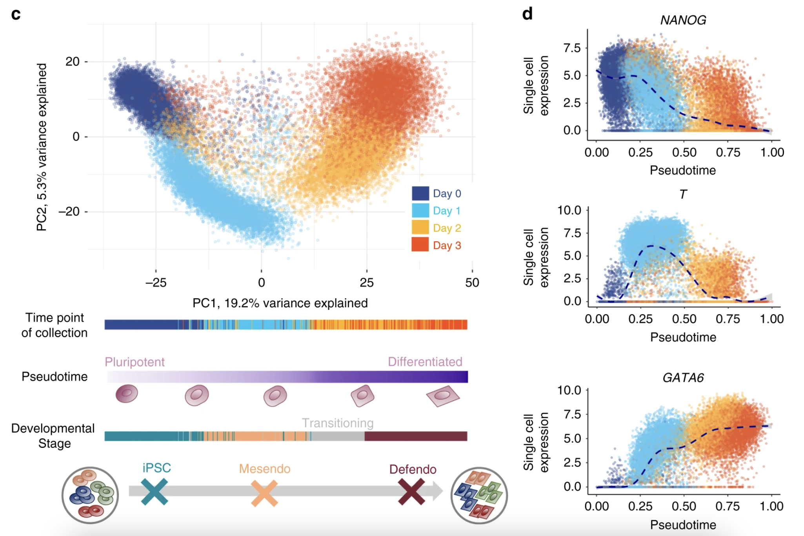
Pseudotiming/trajectory analysis
https://doi.org/10.1038/s41467-020-14457-z

Slide 12
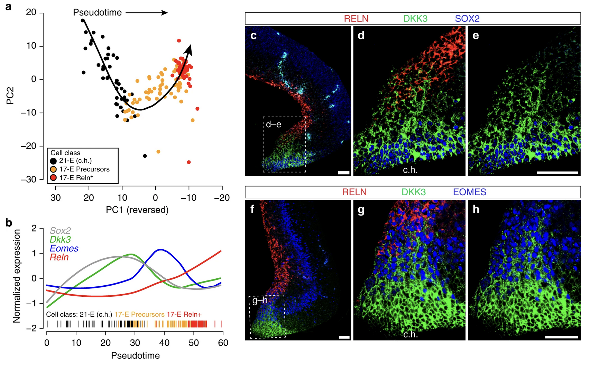
Pseudotiming/trajectory analysis
https://doi.org/10.1038/s41467-018-08079-9

Slide 14
Other single-cell approaches
ATAC-seq
RNA-seq
5’ profiling
TCR/BCR sequencing
Full length (ie Smart-seq)
sci-* (Shendure lab combinatorial indexing)
ChIP-seq/CUT&RUN
scCUT&Tag
Spatial scRNA-seq
10X visium
GeoMx
Single-cell multiomics (performed simultaneously on same cells)
scRNA+scATAC
scRNA + immune/cell surface protein expression
SHARE-seq
Single-cell CRISPR screens
Single-cell lineage tracing

Slide 15
Other resources
Other trainings and vignettes
https://hbctraining.github.io/scRNA-seq/lessons/01_intro_to_scRNA-seq.html
http://bioconductor.org/books/3.13/OSCA.intro/
https://satijalab.org/seurat/articles/get_started.html
Useful papers
Establishing number of cells/depth required:
https://www.biorxiv.org/content/10.1101/218370v1.full
Mouse nervous system
https://www.cell.com/cell/pdf/S0092-8674(18)30789-X.pdf
https://www.nature.com/articles/s41586-021-03775-x
Other web resources
https://portal.brain-map.org/
http://Mousebrain.org
https://cells.ucsc.edu/
https://www.humancellatlas.org/
http://bis.zju.edu.cn/MCA/
https://tabula-muris.ds.czbiohub.org/
https://singlecell.broadinstitute.org/single_cell
Stats help
StatQuest! One helpful example: https://www.youtube.com/watch?v=eN0wFzBA4Sc

